Slide 1
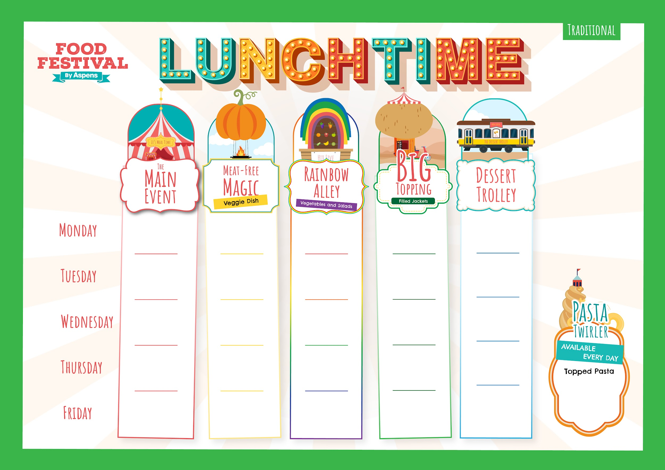

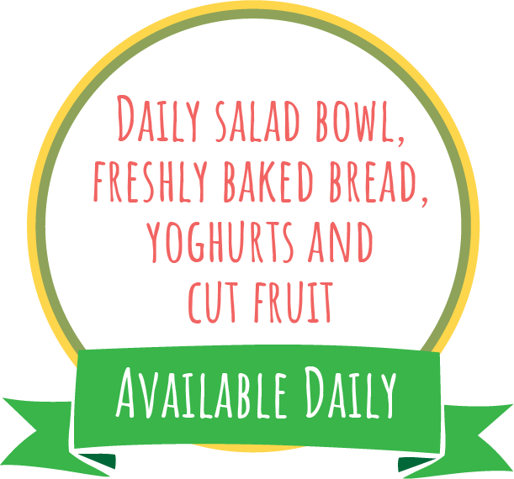
Week 1
Autumn Winter 2024-25:
2/9, 23/9, 14/10, 4/11, 25/11, 16/12, 6/1, 27/1
Margherita
Pizza
Slice and Wedges
Veggie Pepper and Sweetcorn Pizza Slice with Wedges
Sweetcorn
Baked Beans
Beans,
Cheese or
Tuna Mayo
Toffee Frozen Yoghurt
BBQ Cheesy Chicken
Butterbean Ratatouille
Apple Slaw and Wholegrain Rice
Beans,
Cheese or
Tuna Mayo
Sweet Potato Brownie
Roast Gammon,
Roast Potatoes and Gravy
Quorn Sausage,
Roast Potatoes and Gravy
Beans,
Cheese or
Tuna Mayo
Forest Fruits Jelly Pots
Peas
Carrots
Lasagne
Vegetable Lasagne
Green Beans
Sweetcorn
Beans,
Cheese or
Tuna Mayo
Cookie Dough Apple Crumble
Hot Pasta topped with Homemade
Tomato Sauce and Cheese
Golden Fish Fingers or
Salmon Sticks
and Chips
Veggie Patties and Chips
Beans,
Cheese or
Tuna Mayo
Jammy Thumbprint Biscuits
Baked Beans
Peas
T1

Slide 2
Week 2
Autumn Winter 2024-25:
9/9, 30/9, 21/10, 11/11, 2/12, 23/12, 13/1, 3/2
Cheesy Tomato Pizza Muffins
BBQ and Sweetcorn
Pizza Slice
Wholegrain Pasta Salad and Green salad
Beans,
Cheese or
Tuna Mayo
Toffee Apple Sponge and Custard
Chicken and Sweetcorn Cobbler
Winter Vegetable Crumble
Herby Diced Potato and Carrots
Beans,
Cheese or
Tuna Mayo
Chocolate Sprinkle Iced Cake
Roast Chicken, Stuffing,
Roast Potatoes and Gravy
Cauliflower Cheese, Crispy Onion Topping & Roast Potatoes
(You don’t have to have the onions)!
Beans,
Cheese or
Tuna Mayo
Raspberry Coconut Jelly
Mixed Greens
Carrots
Classic
Cottage
Pie
Roasted Sweet Potato Pastry Roll and Mash
Sweetcorn
Peas
Beans,
Cheese or
Tuna Mayo
Fresh Fruit Salad
Hot Pasta topped with Homemade
Tomato Sauce & Cheese
Battered Fish
and Chips
Cheese and Tomato Toasted Wrap with Chips
Beans,
Cheese or
Tuna Mayo
Oaty Coconut
Biscuits
Baked Beans
Peas
T1

Slide 3
Week 3
Autumn Winter 2024-25:
16/9, 7/10, 28/10, 18/11, 9/12, 30/12, 20/1, 10/2
American Style Mac Cheese
Veggie Wholegrain Pasta Bolognese
Carrots
Green Beans
Beans,
Cheese or
Tuna Mayo
Marble
Cake
Sausage Casserole and Mash
Vegetable Pot Pie
and Mash
Roast Root Veggies
Beans,
Cheese or
Tuna Mayo
Apple, Cinnamon Raisin Flapjacks
Roast Chicken, Stuffing,
Roast Potatoes and Gravy
Carrot and Stuffing Pastry Plait
Beans,
Cheese or
Tuna Mayo
Orange and Mango Jelly
Peas
Sweetcorn
Meatballs in Tomato Sauce with Rice
Mild Veggie Bean Chilli Loaded Wedges with Cheese
Broccoli
Carrots
Beans,
Cheese or
Tuna Mayo
Banana Bread Muffins
Hot Pasta topped with Homemade
Tomato Sauce & Cheese
Golden Fish Fingers
and Chips
Vegetable Fingers
and Chips
Beans,
Cheese or
Tuna Mayo
Oaty Coconut
Cookies
Baked Beans
Peas
T1

